Slide 1
SUPPLIER QUALITY · PELVIC BLOCKS
Parks Family Meats
Supplier Calls
Quality Review — Pelvic Blocks · June–July 2026
ATM Incoming Quality · prepared for the Parks + ATM receiving team
Parks Family Meats — Supplier Calls

Slide 2
Parks Pelvic Blocks — June–July Quality Deep-Dive
Slaughterhouse-floor IQC (pre-freeze incoming inspection) · part 666518 · 6 visits, 6/02–7/13/2026
162
135
27
units inspected
passed · 83.3%
scrapped · 16.7%
First-pass yield recovered into the low-80s after May's critical-mesentery event was root-caused and corrected — but a persistent ~17% scrap remains, concentrated in a few recurring defect modes (next slide).
First-pass yield by Parks visit — June–July 2026
Source: Pelvic_Blocks_Quality workbook · Slaughterhouse IQC tab (Parks Visits 8, 11, 13, 14, 16, 19). ATM post-freeze receipts are no longer split by supplier (batch numbers not tracked in Tableau).

Slide 3
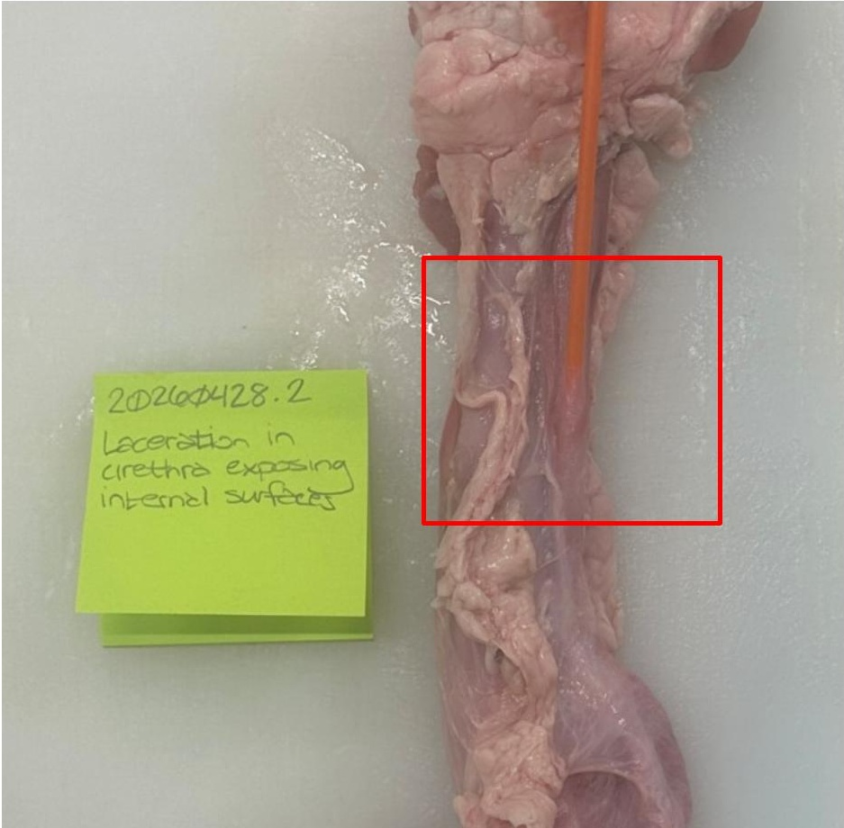
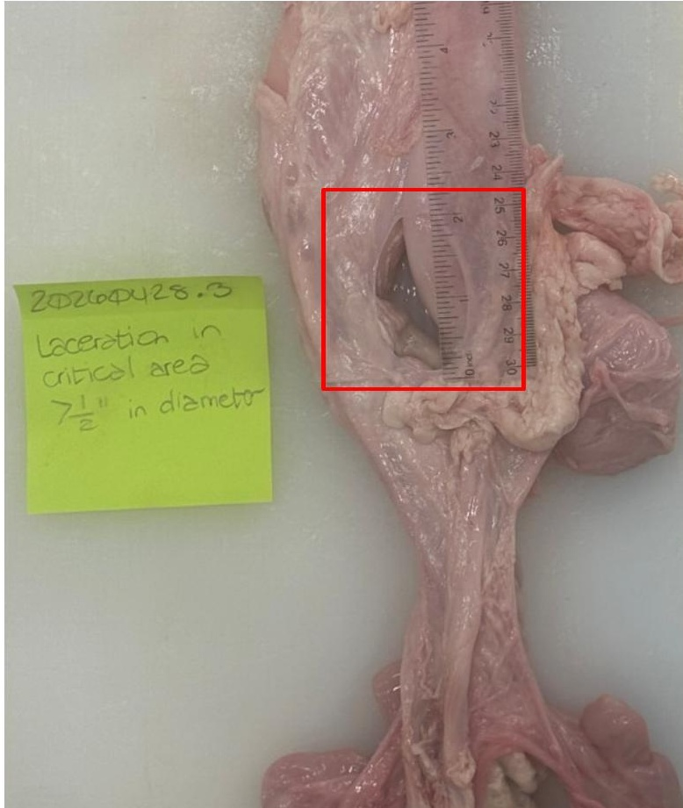
What's driving the scrap — and why
27 rejected units across June–July · ranked by count · spec 668741 Rev F
Urethra / bladder lacerations
12 · 44%
Cuts made too close to the template edge during removal — internal anatomy exposed
Short blocks — mesentery too short
8 · 30%
Small-pig days (Tue/Wed); < 7" mesentery from the bladder neck in the critical zone
Bowel-cleaning bursts
4 · 15%
Bowel blockage inflates and bursts when flushed with water during cleaning
Critical-area mesentery laceration
3 · 11%
Bladder / urethra laceration
Critical-area laceration
668741 Rev F §6.1.2 — internal exposure not allowed
668741 Rev F §6.1.4.1 — > 0.5" in critical area
Residual of the mesentery-dividing cut — root-caused in May, largely corrected
Root-cause read
~3 of every 4 rejects are laceration + short-block issues that trace to the harvesting cut: blades run too close to the template edge (units "looked like they'd pass until placed on the template") and small-pig days leave too little mesentery.
Defect counts from the June–July Slaughterhouse IQC scrap notes. Photos are illustrative reference images (not the specific June–July units).

Slide 4
Root causes → what we're doing about it
For alignment between Parks harvesting and ATM receiving · discussion + actions
Issue | Likely root cause | Mitigation / action | Owner · status
Urethra / bladder lacerations (12) | Blades run too close to the template edge during block removal | Knife-technique refresh; leave margin from the critical edge; check against the template before bagging | Parks + SH tech In progress
Short blocks — mesentery length (8) | Small-pig days (Tue/Wed) leave < 7" mesentery from the bladder neck | Align on the bladder-neck landmark + 7" measure (blue-line guide); flag / segregate small-pig lots | Parks + ATM Align on landmark
Bowel-cleaning bursts (4) | Blocked bowel inflates and bursts when flushed with water | Revised cleaning step for blocked bowels — relieve pressure, don't force water; inspect before cleaning | Parks SOP update (open)
Critical-area mesentery lacer. (3) | Residual of the mesentery-dividing cut (root-caused May) | Continue training + monitoring; verify each month on the SH-floor IQC | Parks + ATM Monitoring
Open questions to align on today
① Lock the bladder-neck landmark + 7" mesentery method so "short block" calls match between Parks and ATM. ② How do we handle small-pig days (Tue/Wed) — flag, segregate, or adjust the cut? ③ Confirm old-spec 666541 units are pulled; next Parks visit set for Aug 12.
Thank you for the work driving this improvement — rejection is already down sharply from the spring.

Slide 5
Follow-up & next steps
Open items from today's call
Did Parks receive the labels and work instructions for the 666541s?
1
Are we missing anything else?
2
NOTE
Leaf fat — quality inspections will be performed today.
Thank you for working with us.

